Slide 1
RAFT Data Strategy
Ver 1.0 2020-09-07

Slide 2
Data Strategy Pillars
How do we use data to grow our business?
Protect data as an asset
Data Education, Culture & Training
Data org design & operating model
Maximize value from Data
“Single product view” initiative
Data Distribution for external market data
Enable the Future
Technology enablement
Data Mngt & Foundational capabilities
Automated reporting
Investment analytics
Get the right data to the right people
Data Ecosystem connectivity

Slide 3
Protect data as an asset
Data Education, Culture & Training
Data org design & operating model
Data Management & Foundational capabilities

Slide 4
Data Governance 2.0
Governance will be provided via 3 different interlinked bodies that will work together
Data Quality
Data Governance
Data Usage & Privacy
Data Usage & Privacy Board: monitoring implementation of the data usage/privacy roadmap, deciding overarching topics and deviations from policies.
Data Governance Board: monitoring implementation of the data management roadmap, deciding overarching topics and deviations from policies.
Data Quality Committees: monitoring implementation of the policies/standards and data quality in a specific data domain.

Slide 5
Core Data Types
Data usage varies as it flows through the value chain, we will have 4 different primary states where data is maintained
IBOR
ABOR
HBOR
Lake
Provider | Front Office Partner(s) | Back Office Partner(s) | Home grown AWS technologies | Home grown AWS technologies
Function | Investment book of record | Accounting book of record | Historical book of record | Raw data pool
Audience | Front Office & Risk | Operations | Performance & Reporting | Business Intelligence
Type | Traded positions | Settlement positions | Time series database | Unstructured (big) data
Purpose | Allows portfolio managers to see their portfolio start of day holdings & cash and real time changes as decisions are made | Allows AAM to prove its compliance with regulations and accounting standards | To show how data has change over time | Allows IM professionals to consume data for their own analysis
Features | Real time position updating | Calculates NAV according to rules (e.g. UCITS, IFRS) | Stores data in date/time stamp sequence | Unstructured data objects
Timeliness | T | T+1 | T+1 onward | T+1
Coverage | Strategies, Portfolios | Client, Seg. Mandate, Fund & subfund | Benchmarks, holdings, prices | Any data class

Slide 6
Current – Future State Differences
Our strategy is to redress the balance of home grown vs commercially available services
325 applications +
299 EUC models
Current
Future
18%
1%
81%
Outsource - SaaS
PaaS
In-house – Commercial Packages
Outsource - SaaS
PaaS
In-house – Commercial Packages
SaaS, Software as a Service, where the application, technical services and hardware are managed by the vendor​
PaaS, Platform as a Service, where we manage the application on a cloud vendor’s technical services and hardware​
IaaS, where we manage the application and technology services on a vendor’s hardware​

Slide 7
AAM Application of Core Data Principles
We will add 5 data principles to the already agreed group principles and RAFT project principles
Group Architecture Principles
1 | Accessibility
2 | Transparency & Tractability
3 | Digital native
4 | Privacy & data protection
5 | Standardisation
6 | Sustainability
7 | Trustworthy
8 | Value
9 | Functionality
10 | Agility
RAFT Project Principles | RAFT Data Principles
One global platform
Partners host their own technology | Operational data comes from operational systems
We learn best practice from our partners | Data in cloud, no on-prem data
Fastest time to market | Partners must prove data privacy & protection
Simplify and save | Partners deliver data to our data lake only
Vendor(s) do the work | Cross function data comes from the data lake
See also appendix 1

Slide 8
AAM Data Principles
We will follow the following 5 data principles when we design the RAFT implementation strategy
Principle | Rationale
Operational data comes from operational systems | We are buying outsource services, not commercial off-the-shelf software packages that we own and run We do not want responsibility for software upgrades Vendors manage change projects and not AAM
Data in cloud, nothing on-prem | Users have one data source and user interface Access controls are easier to maintain and audit Data is always contextually correct and up-to-date
Partners must prove data privacy & protection | Technology simplification Cost reduction Easier to flex up or down
Partners delivery data to our data lake only | One delivery pattern for all partners Single point for data sources and uses governance Data is in one place
Cross function data comes from the data lake | No need for local data collection from different sources, transformation and merging Data access and privacy is centrally controlled Data usage can be metered (cost control)

Slide 9
Maximize value from Data
“Single product view” initiative
Data Distribution for external market data
Automated reporting
Investment analytics

Slide 10
Objective
We will improve the way we capture, store, manage, share and use data
Capture
Outsource partners capture the data their platforms need
Partners store the data their outsourced function needs
Store
Business steers data priorities
Manage
Data Management becomes an oversight function and not a core business capability
Data enables the business
Data lake is the single place where we consolidate data from partners
Share
Use
We lever advanced AI and analytics for cross function data analysis

Slide 11
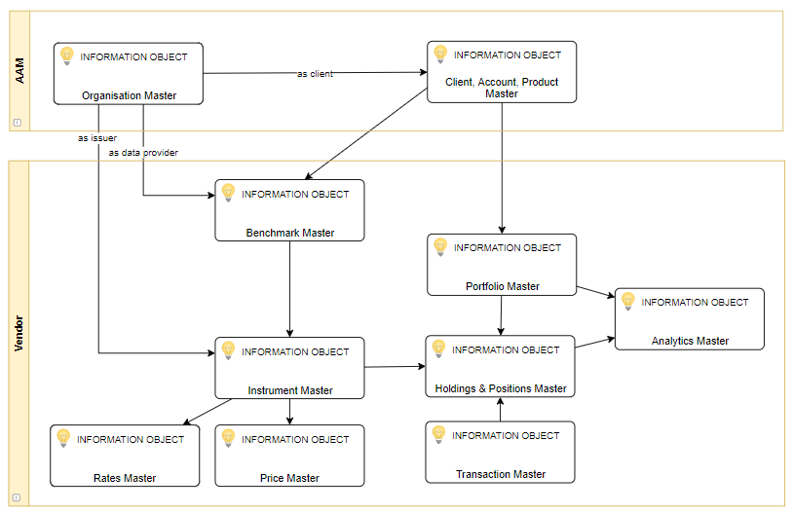
Core Asset Management Data Classes
10 different data super-classes need to be maintained, linage for each data class will be maintained

Slide 12


Understanding data linage
We will fully document our data linage. An example, the current "transaction" data class lifecycle
Investment Desk
Proposed Order
Pre-trade Compliance
Order
Placement
Block
Trade
Fill
Allocation
Allocation
Aladdin
Confirmation
Aladdin
thinkFolio
SimCorp
Citi
SWIFT Message
Send to Custodian
Settlement Instruction
Enrichment
Financial Accounts
Record Keeping
Confirmed Allocation
Client’s Custodian
PAM
State Street
SimCorp
Citi

Slide 13

Current State Data Integration Differences
NL
UK
US
Vision
Data Loading
Integrity Checking
Transport
Data Mastering
Canonical Formatting
Transport
Target Formatting
Target App
Transport
DWH Formatting
Warehouse
Reporting
Instrument Data
MEDM UK
Comms. Bus
SQL (SSIS)
Target App
SQL (SSIS)
AMIS
Bus. Objects
Partner Data
SQL (SSIS)
Comms. Bus
AMIS
SQL (SSIS)
Market Data
Instrument Data
MEDM UK
Target App
SQL (SSIS)
IDB
SQL (SSRS)
Partner Data
Market Data
Instrument Data
MEDM US
Target App
Partner Data
Informatica
IDW
Informatica
Informatica
IDW
Bus. Objects
Market Data
Instrument Data
AWS S3
U-MEDM
AWS Data Sync
AWS Glue
Target App
AWS Data Sync
AWS Glue
U-DWH
Power BI
Partner Data
Market Data

Slide 14
Current State (Need a picture of current state)
Each office has pursued its own data strategy and adopted different tools
Office | Capture | Store | Manage | Share | Use
US | Information Markit EDM | Oracle MS SQL Server | Separate Data Management Team check data integrity | Informatica MS Access Control M | Business Objects
NL | Markit EDM | Oracle MS SQL Server | Separate Data Management Team check data integrity | Home grown Communications Bus GECS | Business Objects
TKPI | Markit EDM End user computing | MS SQL Server | Separate Data Management Team check data integrity | End user computing | End user computing
UK | Markit EDM | MS SQL Server | Separate Data Management Team check data integrity | MS SQL Server Integration Services | MS SQL Server Reporting Services
Conclusion | No market data collection standard pattern Markit EDM’s are each configured differently | Different data structures and technologies NL use Oracle for SimCorp Dimension | Data governance is local | Batch based data transfer dependence Different tools in each office | Disparate technologies

Slide 15
Integration capability | NL | UK | US | Vision
Data loading | MEDM SSIS | MEDM | Informatica | Data Lake | Consume data straight into cloud and eliminate on-prem tools. Data transport must support dual on-off prem options in interim
Integrity checking | MEDM Partial | MEDM | MEDM Partial | ? | All data sources pass through UK MEDM, others limited to instruments
Data mastering | MEDM Partial | MEDM | MEDM partial | MEDM Partial | All data sources pass through UK MEDM
Data Transport | Comms Bus | SSIS | Informatica | AWS Data Sync | Adopt commodity tech to eliminate specialist middleware & home grown solutions. Significant rewrites add no business value
Canonical formatting | SSIS | N/A | N/A | N/A | XML canonical format dropped in future state
Target system reformatting | SSIS | MEDM SSIS | Informatica | Glue | Team reskilling. Significant rewrites add no business value
Data warehousing | AMIS | IDB | IDW | S3 | Team reskilling. Single consolidated data source but significant dev.
Reporting | Bus. Objects | SSRS | Bus. Objects | Power BI | Team reskilling but evolution from SSRS. Significant rewrites add no business value

Slide 16
Enable the Future
Technology enablement
Get the right data to the right people
Data Ecosystem connectivity

Slide 17


Strategies for adopting the cloud
There are six core industry strategies we can deploy to move from our capabilities and applications to the cloud. We will use Retire and Re-purchase because at the same time we can upgrade our capabilities and adopt industry best practice
Retire | This is where the business capability is no longer required for various reasons and therefore we simply seek to stop offering it.
Re-Purchase | This is where we seek an outside provider to supply us with this business capability. Whilst this gets the capability off the data center it also means the capability is not moving onto our public cloud.
Retain | This is the choice to keep a capability within the data centers. AGT is likely to outsource remaining data centers resulting in a forced “Re-purchased”
Re-host | Sometimes referred to as “lift and shift” this is where the capability is replicated on the new platform. This is often the quickest rout to get a capability onto the cloud but severely limits the benefits of the cloud.
Re-platform | This is a middle ground between re-host and re-factor. Rather than fully recreating the capability to be cloud native smaller changes are made to get
Re-factor | This is where the capability is fully redeveloped into a cloud native solutions. Which results in a longer transfer time but does give the full benefit of a cloud capability.
Increasing complexity, effort and reward

Slide 18
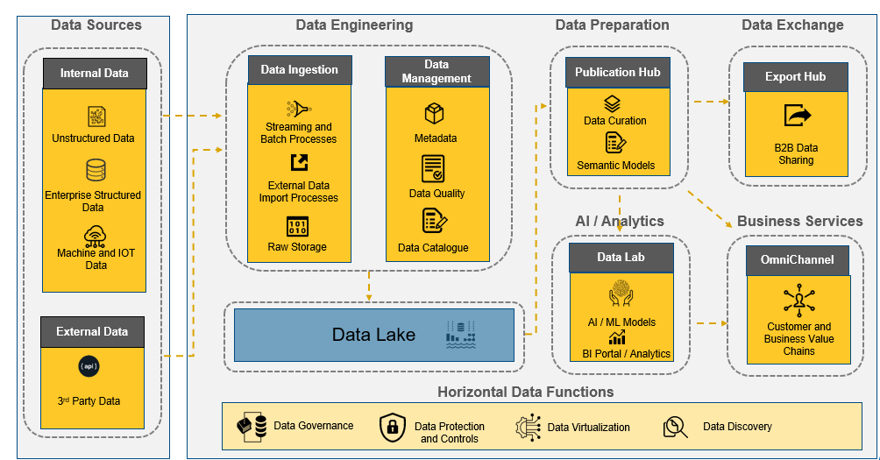
AAM Data Lake
The Cloud Data Platform Reference Architecture is used as the basis for the AAM Cloud platform design
Overview
Cloud services to provide elastic scalability
Data is handled and processed in a secure, controlled and compliant manner
Data roles and responsibilities are partitioned according to specific requirements
Enables the use of data to enhance business services, automate internal processes, and maintain a continuous conversation with the customer and the wider market

Slide 19
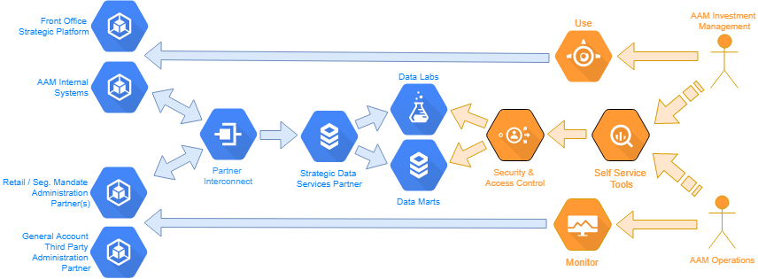
Summary: Outline Design
Partners provide systems to support core business capabilities, we use data for differentiation via our own data layer and tools
Our various specialist front and back office disciplines will use the tools provided by our selected partners for day-to-day operational processing and monitoring
Our chosen partners must build connectivity to our chosen strategic data services partner; most connectivity can be completed using industry standard SWIFT messages
Our chosen partner will create separate data marts and marts for use by specific AAM communities that need access to data
We will provide self-service tools (e.g. MS Power BI) to access the data that has been made available
Data Sources
Data Engineering
Data Lake
Data Preparation
Data Analytics
Data Services

Slide 20
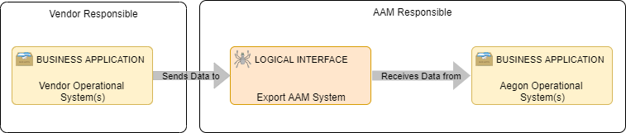
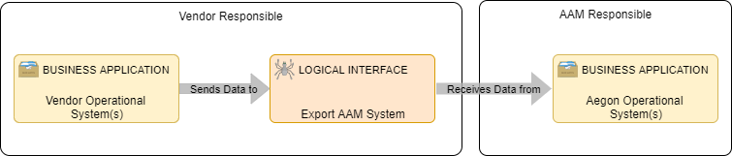
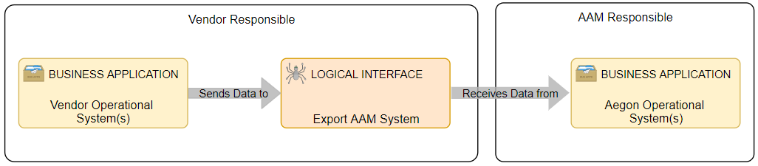
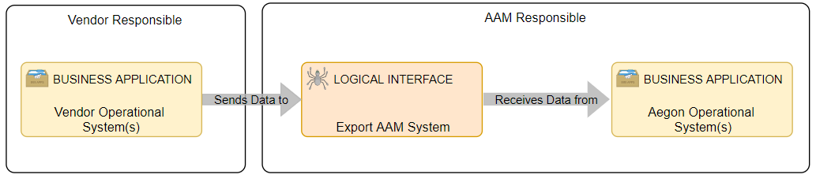
Logical Interface Patterns
Integration with our chosen vendors can be complete via two options, we may need to support both
Options | #1:Click and collect: AAM pull data from the vendor warehouse | #2: Delivery service: The vendor delivers data to AAM internal systems
Pros | Integration is under AAM's control AAM control interfaces maintenance and change timelines The database design is under AAM control | No internal data integration team needed No internal production support team needed Can monitor status via dashboard and manage to an agree SLA
Cons | Need an internal integration team Need internal production support and job scheduler Still need vendor when new attributes are needed in the database schema | Increased dependence on vendor Speed of change dictated by vendor capacity and methodology Need vendor to extend the database schema

Slide 21
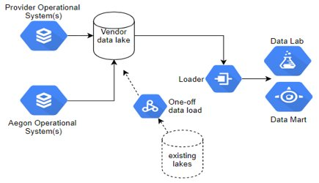
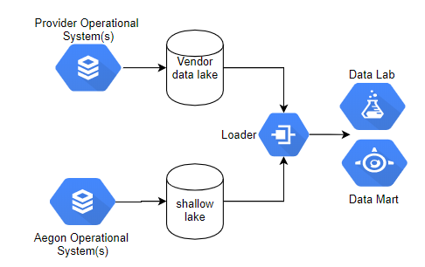
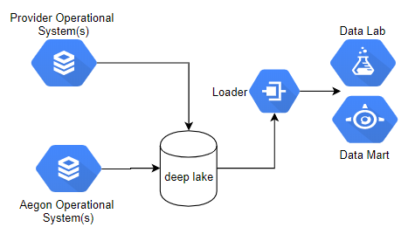
Data Storage Patterns
There are three board options …
Options | #1: No Lake: Vendor provides data lake | #1: Shallow lake: Split vendor & AAM lakes | #2: Deep lake: Vendors provide data to our lake
Pros | No internal lake to maintain Out-of-the-box for most asset classes Vendor loads our existing historical data | Vendor lake for supported asset classes Vendor lake is out-of-the-box AAM lake only for non-vendor asset classes | Lake is under AAM control Can lever AGT AWS One lake for all AAM asset classes
Cons | Additional vendor dependence Vendor must take-on our history Vendor must build interfaces and missing data | OpEx to maintain an internal data lake Our current AWS technology is immature We must converge data from two lakes | OpEx to maintain an internal data lake Our current AWS technology is immature We must migrate history from multiple legavy warehouses

Slide 22
Appendices

Slide 23
Group Architecture Principles
Group Enterprise Architecture have 10 key principles that solutions must be measured against
Principle | Description
Accessibility | Data and information are key to Aegon's decision making and governance processes. It has value and should therefore be carefully managed in terms of location, storage, reliability of content and access. Summary: Store Data in EcoSystem(s), Audit trails, Up-to-date, Timely
Transparency & traceability | It is important that a solution and the usage of data is transparent and traceable. This includes the way the solution processes information, provides access to users and achieves its total cost of ownership. Summary: Fee-based pricing, Result reasoning, Audit trail
Digital native | - Design for user needs, flexibility, scale, performance & reuse
Privacy and data protection | Privacy and security are increasingly important in a(n online and) data centric world. Aegon wants to be trusted by its customers, employees and other stakeholders. They must rely on Aegon that their personal data is protected and that the integrity and confidentiality of all data is guaranteed. Summary: Design for Privacy & Security, Control use of Pi/PII, Customers control
Standardization | Some solutions are deemed critical for the correct functioning of the enterprise architecture and/or adherence to global standards besides the more traditional advantages re standardization . These solutions are carefully chosen based on gathered requirements and market research. Summary: Reuse < Buy < Build Arch. Patterns, Coding Standards & pipelines
Sustainability | Ensure business critical solutions will stay running correctly in the future as well as ensuring lengthening the lifespan of critical legacy in the digital reality. Summary: Business owner, Maintainability, LifeCycle Mgt, Fix Legacy Apps, Sustainable partners
Trustworthy | Customers of Aegon must be comfortable that their privacy, integrity and confidentiality of personal identifiable data/information is protected irrespective of how/where the data is stored/transferred/processed and or altered. Summary: Secured Data Lake, Controlled Data Quality, Regulated, Safe, Reliable & Secure
Value | In order to understand the impact of change in the IT landscape, insight in (and insight in the balance between) a number of topics going beyond the base price of the solution is required. Summary: cost overrun, functionality missing, poor support
Functionality | Traditional solutions tend to be monolithic by nature (for example they cover administration, customer service delivery and customer interaction). Monolithic solutions do not enable flexibility. Summary: Separate de-coupled functions, Product Systems support interaction
Agility | While the priorities and requirements of the business may change in the future and new technology will become available/introduced each day, the architecture will enable introducing change at a fast pace and prevent vendor lock in. Sumary: Demarcate, API-enabled, Open Standards, CI / CD

